Slide 1
Shopping Wizard
Jerfferson Bertinoti
Erick Ayala
Sergio Bermudez
Robert Baguena

Slide 2
First steps
Task 1
Project idea and logic application with assignation of each duty.
Task 2
Structuring HTML, CSS .
Task 3
Divided ongoing duties with the homepage, forms, events, functions

Slide 3
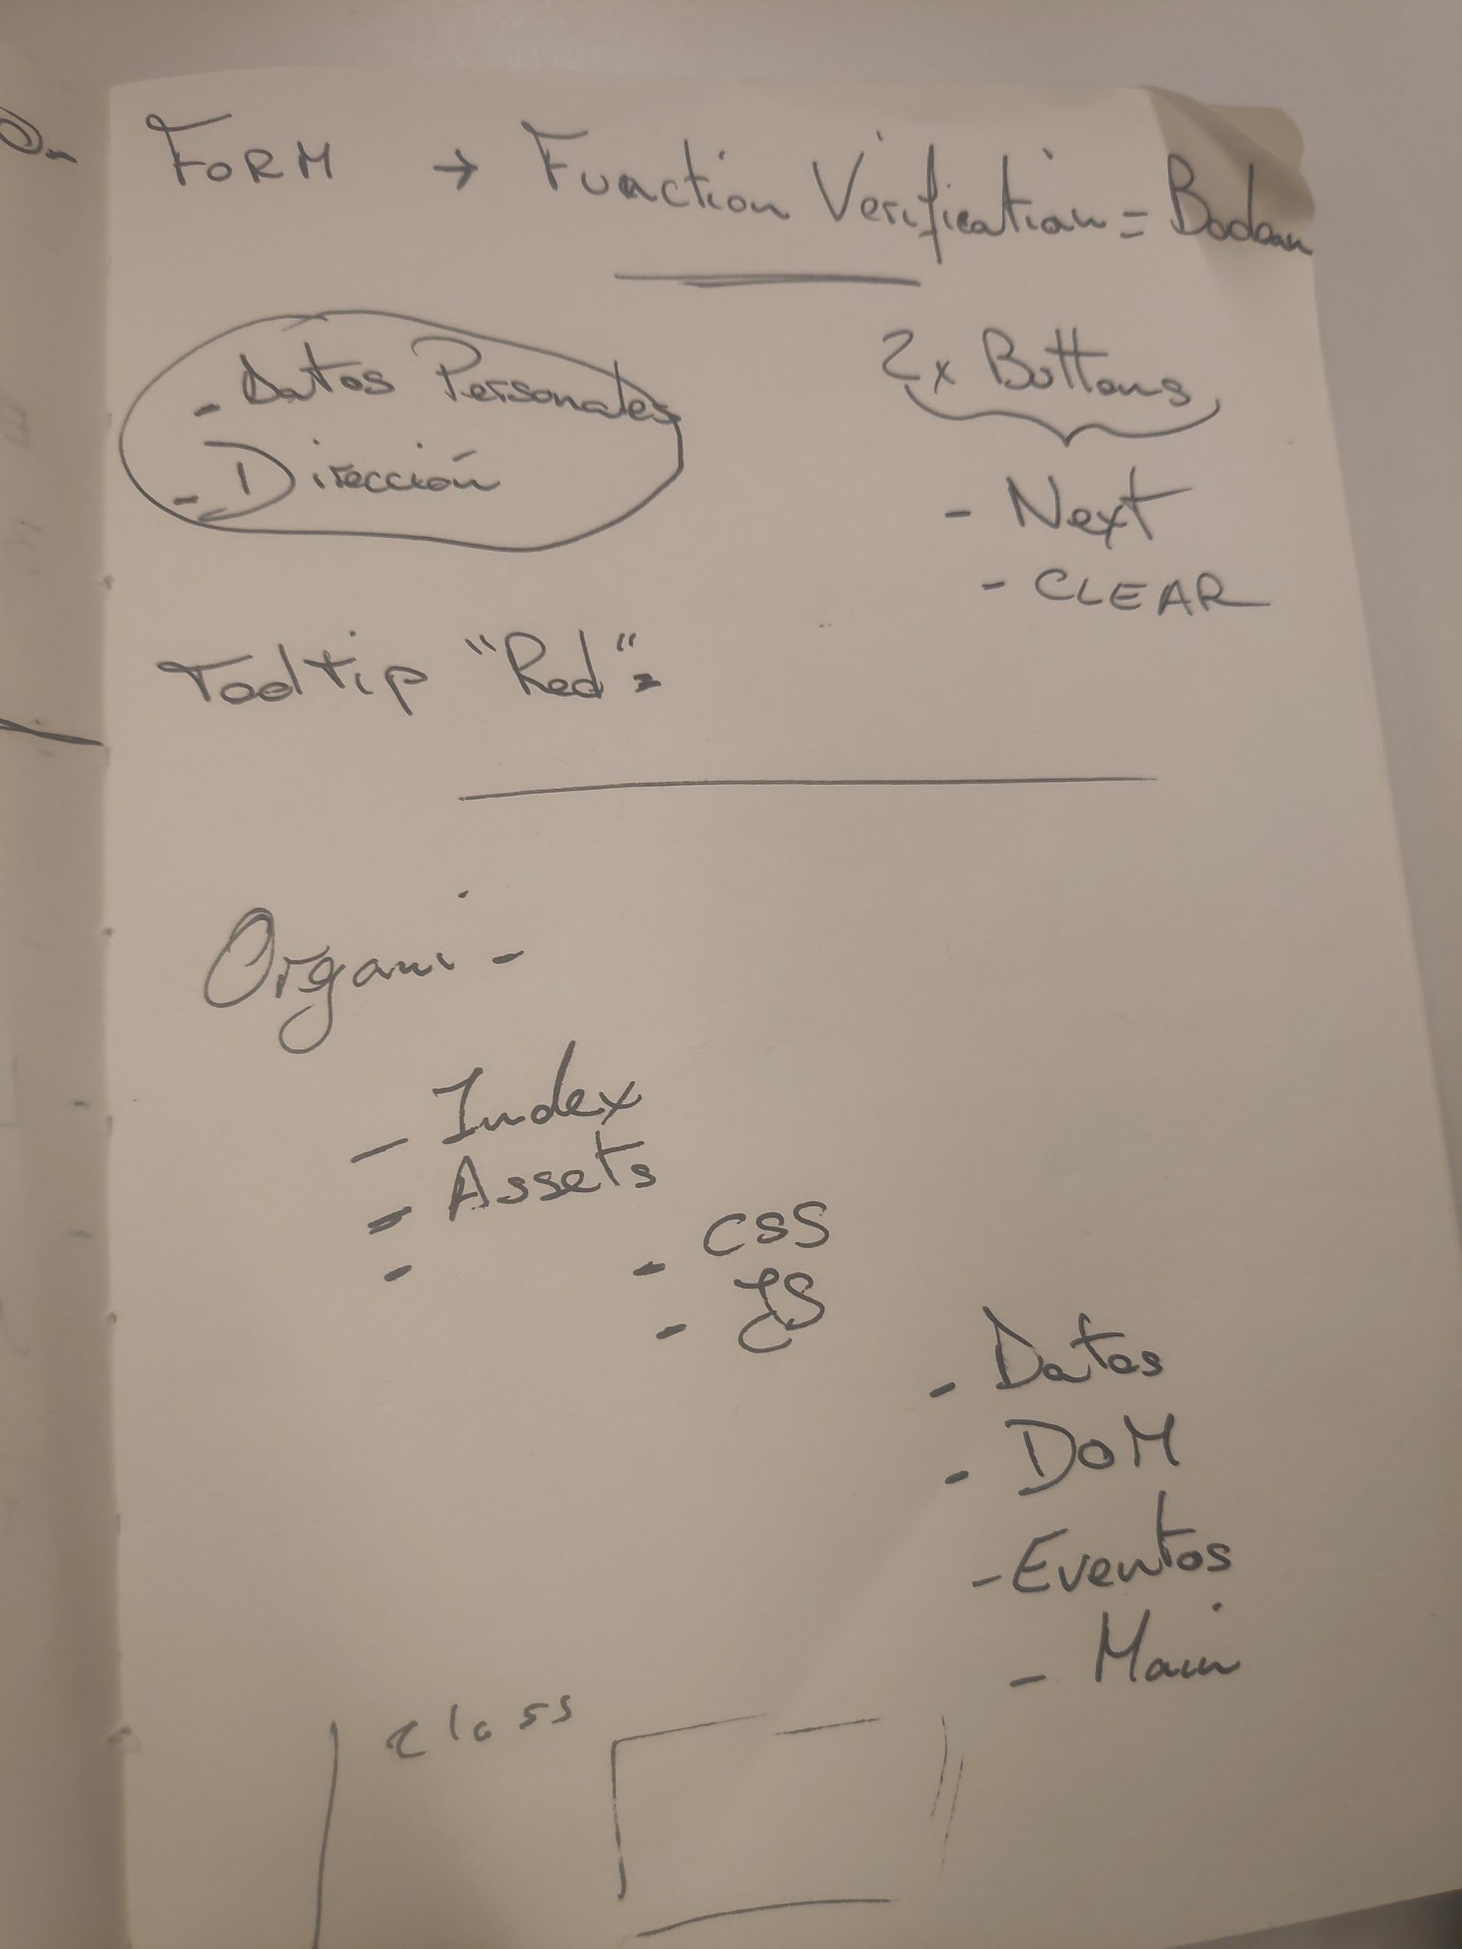
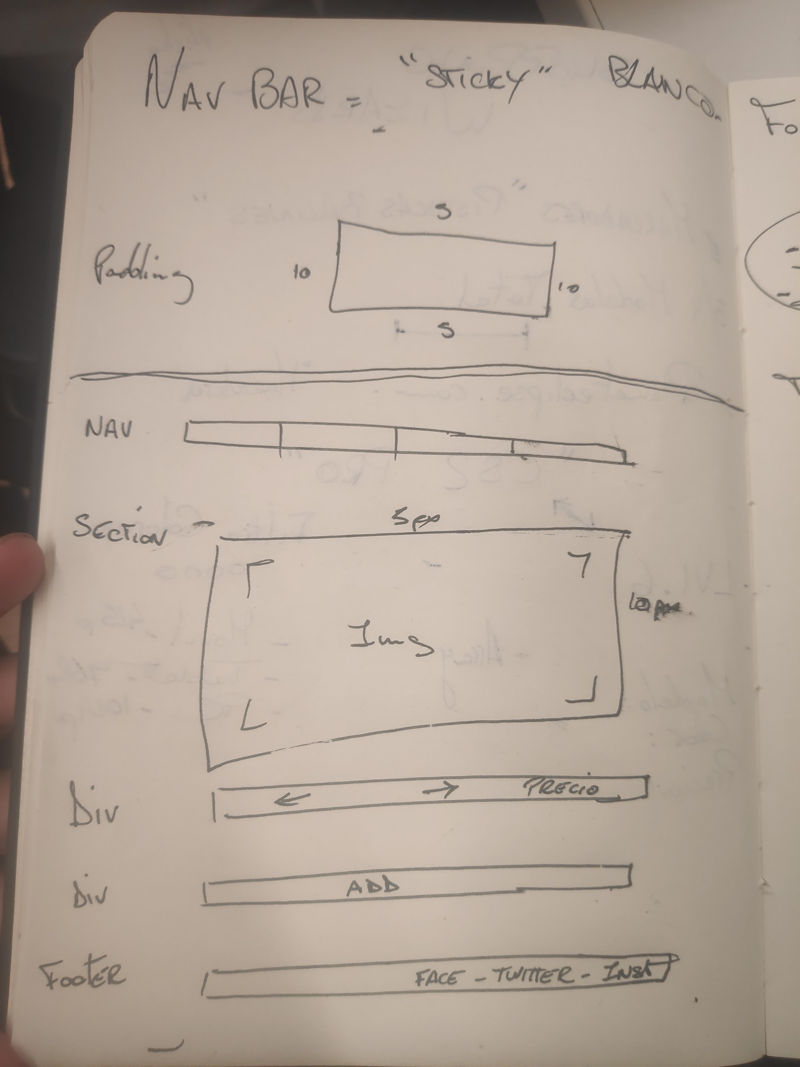
Project idea
Project idea and logic application with assignation of each duty.

Slide 4




Structuring HTML and CSS
Divided in group of two
Make a new branch for each one
Once finished we merged all the changes to the main

Slide 5
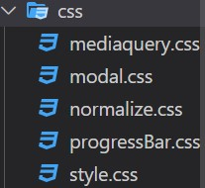
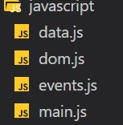
Structure

Slide 6




Achievements
Worked in team.
Improve of CSS.
Javascript knowledge.
improved knowledge of git and git-hub.
use of commands and learn how to deal with the merges.

Slide 7
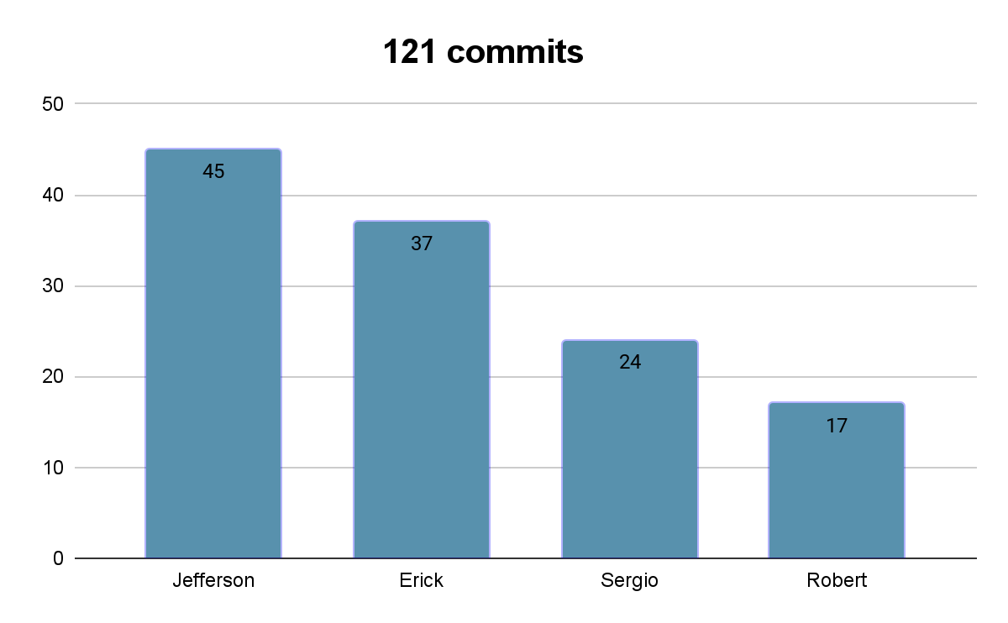
Total of commits
We have pushed a total of 121 commits to main and 123 to all branches. On main there have been 1797 additions and 126 deletions.

Slide 8



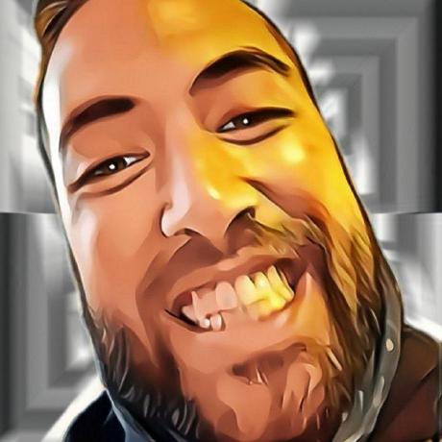
Github
bertinoti
erickayalarias
sergiogt93
MrMhirs
SHOPPING-WIZARD

